Slide 1
Digital Design II
MINI PROJECT (DEF TO SVG)
AHMED ABOUZAID 900163141
AHMED FAHMY 900160127

Slide 2
Project Description & Requirements
Develop a converter that gets a routed design in DEF format as well as the standard cell library (SCL) LEF file and produces a layout in SVG (Scalable Vector Graphics) format. Use any open source library (e.g., google “svg pan zoom lib” ) to create a small viewer to display the generated SVG (must support zooming and panning). Bonus (2%): Add the ability to highlight the flip-flops and the clock nets (clock distribution network)

Slide 3
Project phases
Parsing DEF and LEF file
Plotting components, VIAs, Nets on SVG image
View the output on QT to enable panning and zooming

Slide 4
Project Implementation (parsing phase)
Use the DEF and LEF parsing functions to get the following information:
From DEF File | From LEF File
Components coordinates | Die area size
VIAs coordinates | Components size
Nets coordinates | VIAs size
Pins coordinates | Pins size

Slide 5
Project Implementation (plotting phase)
We used svgwrite library to plot components, nets, and VIA, pins shapes into the specified coordinates.

Slide 6
Project Implementation (QT viewer)
To enable zooming and panning, we used PyQt library

Slide 7
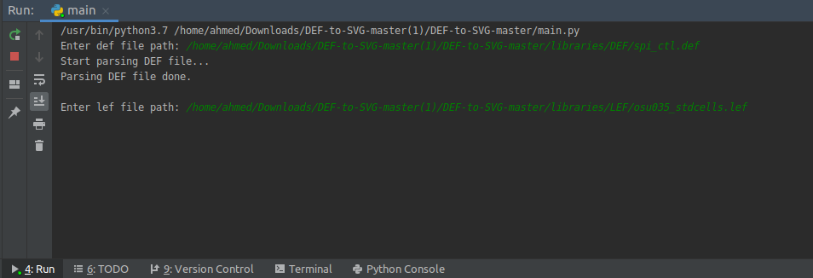
How to run the project (1)
Using any python IDE, users need to have the path of the DEF and LEF file to run the program as shown below

Slide 8
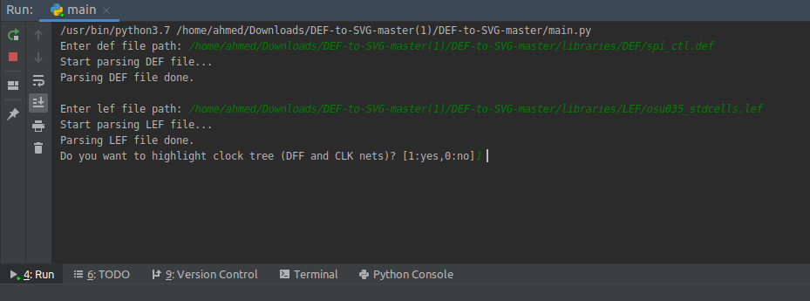
How to run the project (2)
After deciding which def and lef files will be used, users choose either highlight the DFF and CLK nets or not as shown.

Slide 9
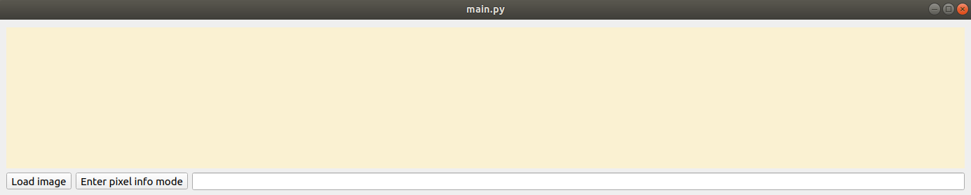
How to run the project (3)
Click on load image when the QT viewer popup, as shown below

Slide 10
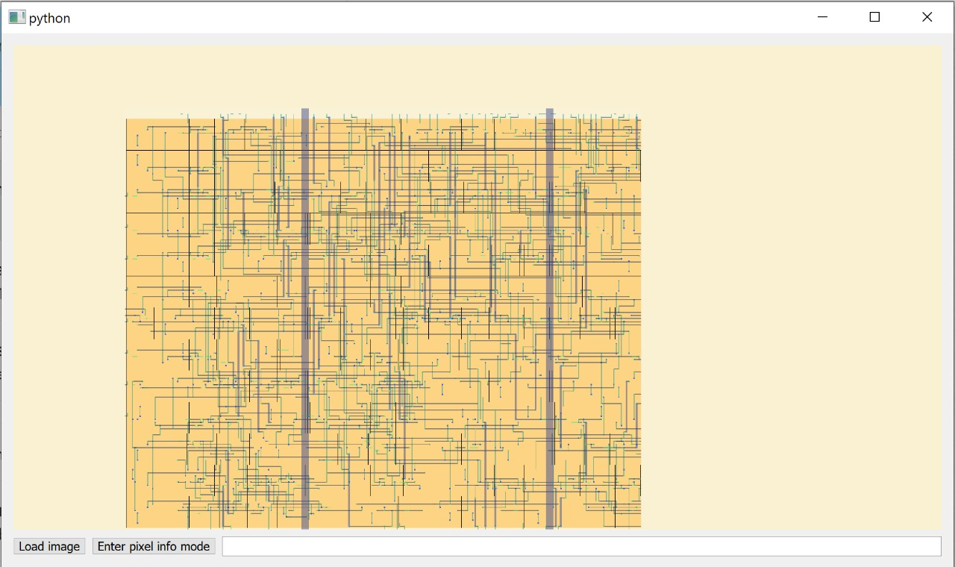
How to run the project (4)
The generated svg will be displayed if user chose not to highlight DFF and CLK Nets

Slide 11
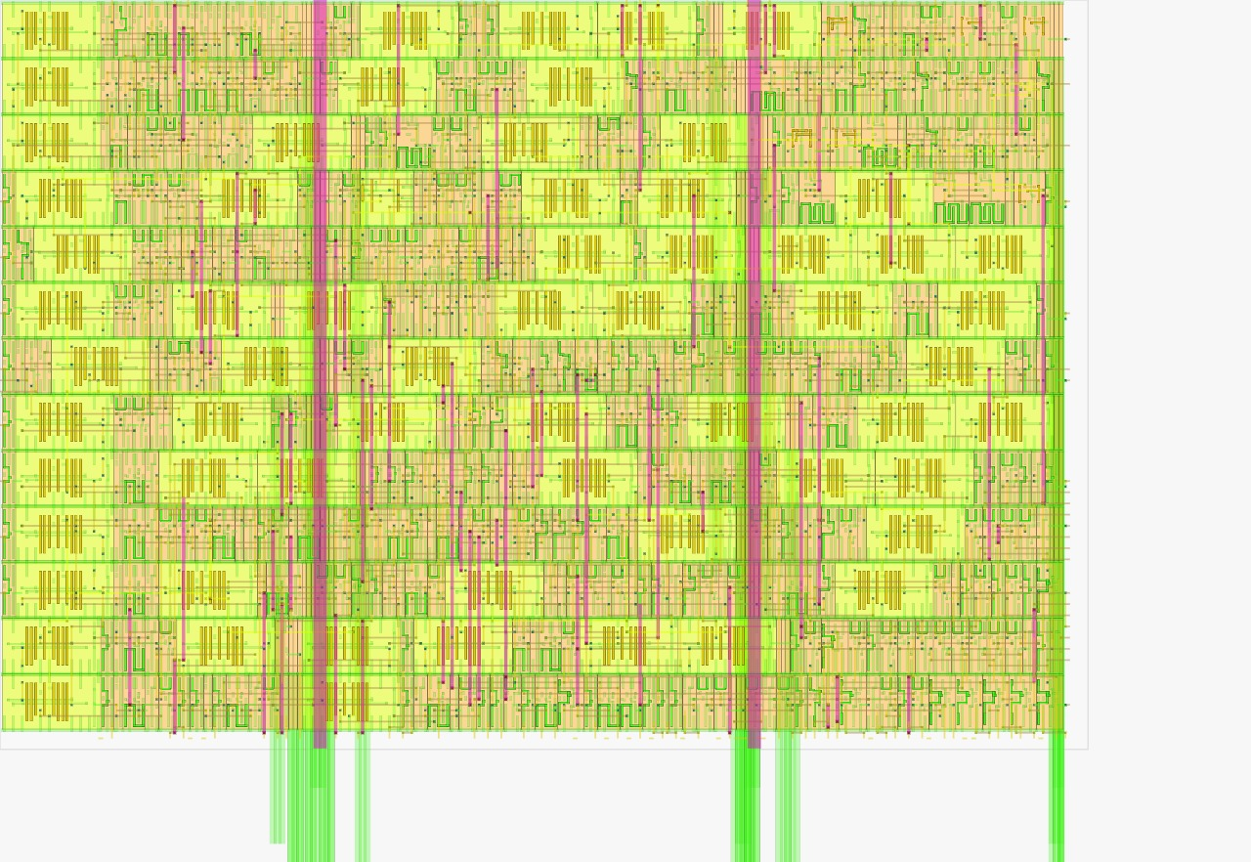
How to run the project (5)
The generated svg will be displayed if user chose to highlight DFF and CLK Nets

Slide 12
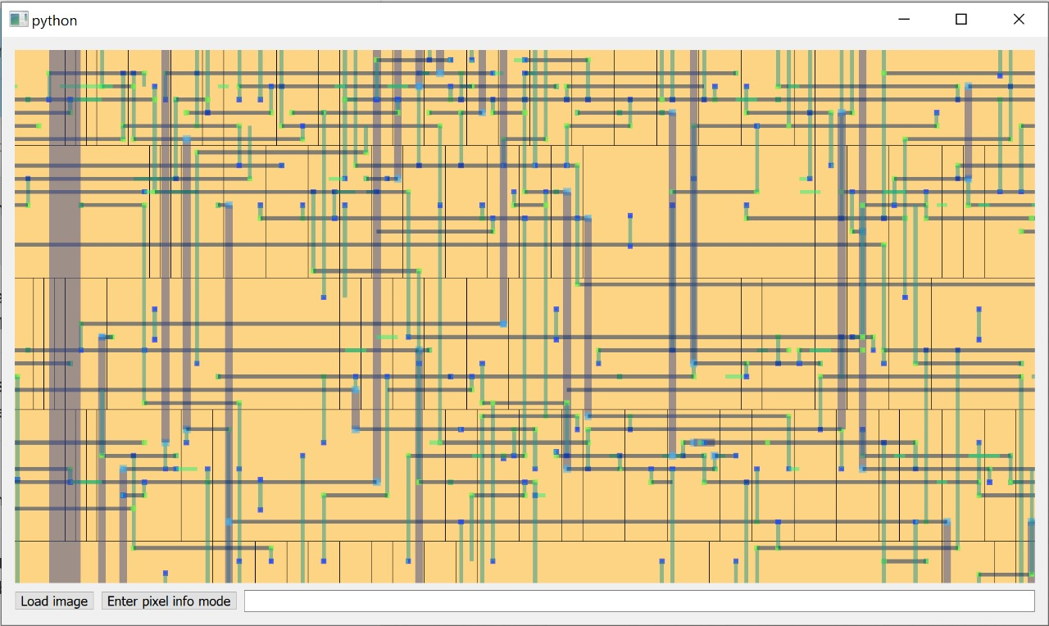
How to run the project (6)
You will be able to pan and zoom as shown using

Slide 13
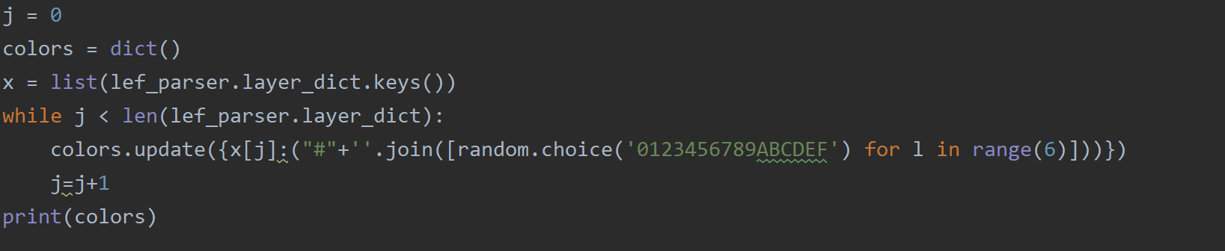
Code details
Generate layer colors by randomizing colors in hash

Slide 14
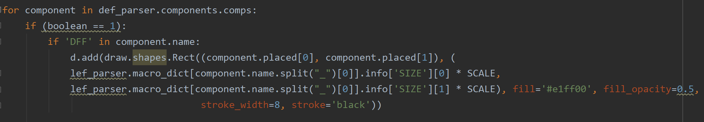
Code details
Draw components and their internals
highlight DFF if user selects the option
Account for orientations

Slide 15
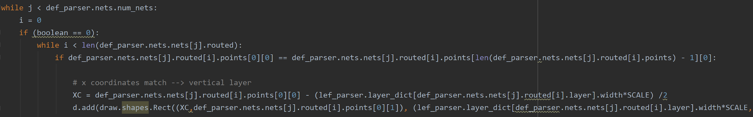
Draw nets from DEF file
Account for scaling issues between DEF and LEF
Extract net layer width from LEF
Account for direction issues while drawing SVG
Highlight clk tree if user selects option
Draw Vias and center them

Slide 16
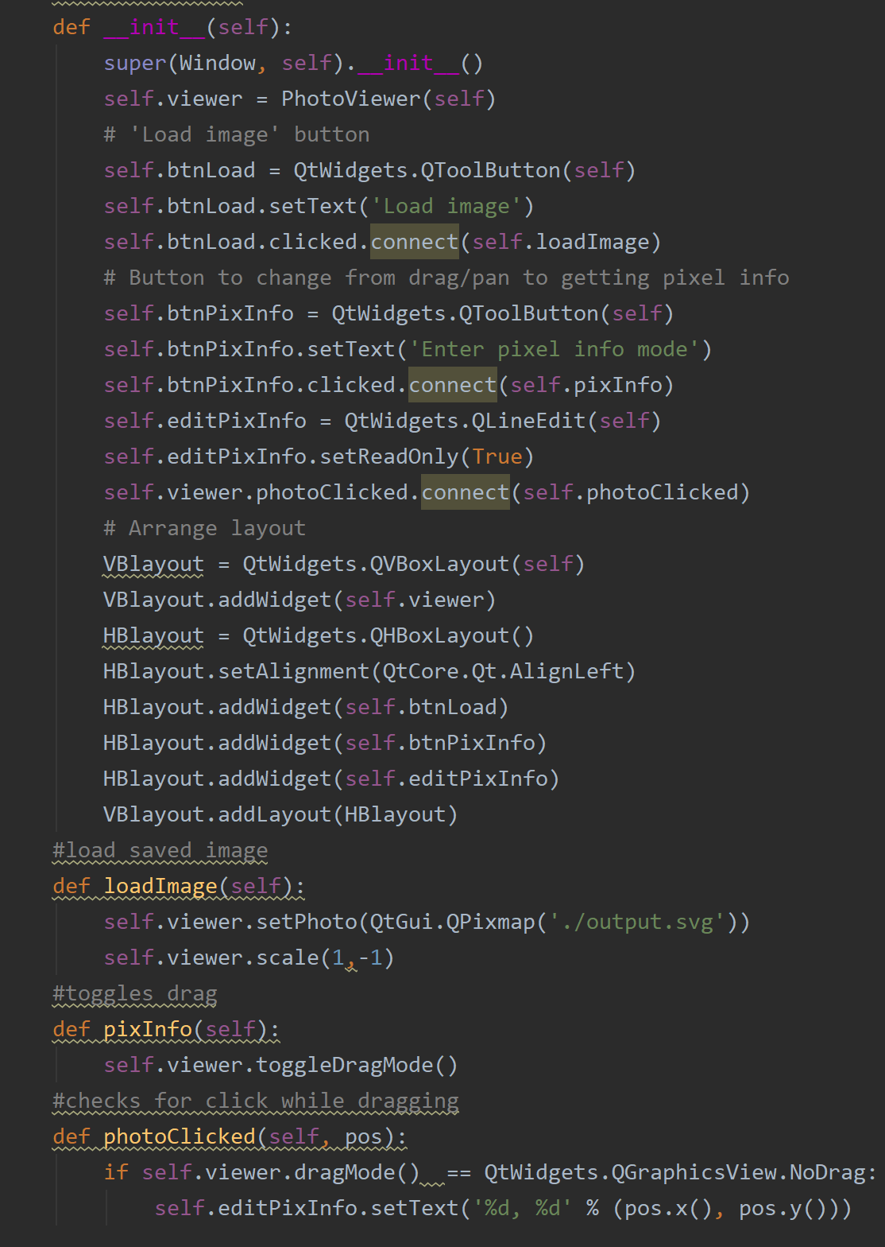
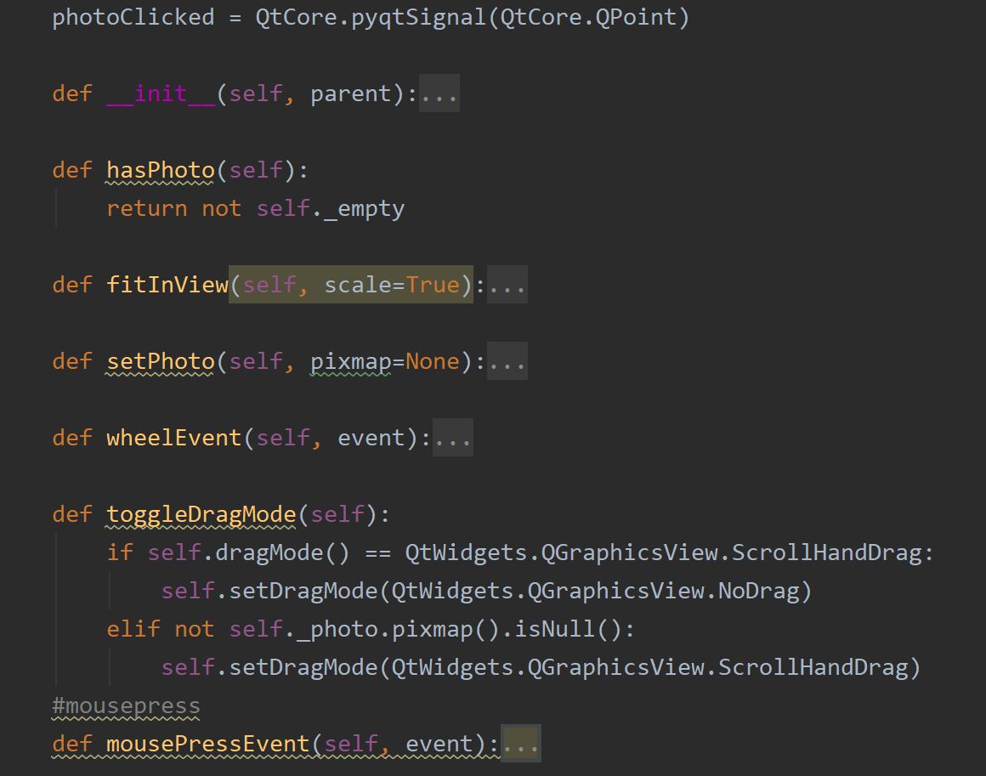
GUI definitions (QT)

Slide 17
Limitations
No Support for SPECIALNETS statements in def
QT viewer fails to load extremely large designs (Opens all samples except “sha1_core.cpu”, yet SVG is generated).

